Slide 1
CS 252 Database Management Systems
Jan – May 2020
IV Semester
* Use the slides for reference only. Refer the text book for details.

Slide 2
Basic SQL
SQL language
Considered one of the major reasons for the commercial success of relational databases
SQL
The origin of SQL is relational predicate calculus called tuple calculus (see Ch.8) which was proposed initially as the language SQUARE.
SQL Actually comes from the word “SEQUEL” which was the original term used in the paper: “SEQUEL TO SQUARE” by Chamberlin and Boyce. IBM could not copyright that term, so they abbreviated to SQL and copyrighted the term SQL.
Now popularly known as “Structured Query language”.
SQL is an informal or practical rendering of the relational data model with syntax

Slide 3
SQL Data Definition, Data Types, Standards
Terminology:
Table, row, and column used for relational model terms relation, tuple, and attribute
CREATE statement
Main SQL command for data definition
The language has features for : Data Definition, Data Manipulation, Transaction control, Indexing, Security specification, Active databases, Multi-media, Distributed databases etc.

Slide 4
SQL Standards
SQL has gone through many standards: starting with SQL-86 or SQL 1.A. SQL-92 is referred to as SQL-2.
Later standards (from SQL-1999) are divided into core specification and specialized extensions. The extensions are implemented for different applications – such as data mining, data warehousing, multimedia etc.
SQL-2006 added XML features; In 2008 they added Object-oriented features.
SQL-3 is the current standard which started with SQL-1999. It is not fully implemented in any RDBMS.

Slide 5
Schema and Catalog Concepts in SQL
We cover the basic standard SQL syntax – there are variations in existing RDBMS systems
SQL schema
Identified by a schema name
Includes an authorization identifier and descriptors for each element
Schema elements include
Tables, constraints, views, domains, and other constructs
Each statement in SQL ends with a semicolon

Slide 6
Schema and Catalog Concepts in SQL
CREATE SCHEMA statement
CREATE SCHEMA COMPANY AUTHORIZATION ‘Jsmith’;
Catalog
Named collection of schemas in an SQL environment
SQL also has the concept of a cluster of catalogs.

Slide 7
CREATE TABLE Command in SQL
Specifying a new relation
Provide name of table
Specify attributes, their types and initial constraints
Can optionally specify schema:
CREATE TABLE COMPANY.EMPLOYEE ...
or
CREATE TABLE EMPLOYEE ...
Base tables (base relations)
Relation and its tuples are actually created and stored as a file by the DBMS
Virtual relations (views)
Created through the CREATE VIEW statement. Do not correspond to any physical file.

Slide 8
Attribute Data Types and Domains in SQL
Basic data types
Numeric data types
Integer numbers: INTEGER, INT, and SMALLINT
Floating-point (real) numbers: FLOAT or REAL, and DOUBLE PRECISION
Character-string data types
Fixed length: CHAR(n), CHARACTER(n)
Varying length: VARCHAR(n), CHAR VARYING(n), CHARACTER VARYING(n)
Bit-string data types
Fixed length: BIT(n)
Varying length: BIT VARYING(n)
Boolean data type
Values of TRUE or FALSE or NULL
DATE data type
Ten positions
Components are YEAR, MONTH, and DAY in the form YYYY-MM-DD
Multiple mapping functions available in RDBMSs to change date formats

Slide 9
Attribute Data Types and Domains in SQL
Additional data types
Timestamp data type
Includes the DATE and TIME fields
Plus a minimum of six positions for decimal fractions of seconds
Optional WITH TIME ZONE qualifier
INTERVAL data type
Specifies a relative value that can be used to increment or decrement an absolute value of a date, time, or timestamp
DATE, TIME, Timestamp, INTERVAL data types can be cast or converted to string formats for comparison.

Slide 10
Attribute Data Types and Domains in SQL
Domain
Name used with the attribute specification
Makes it easier to change the data type for a domain that is used by numerous attributes
Improves schema readability
Example:
CREATE DOMAIN SSN_TYPE AS CHAR(9);
TYPE
User Defined Types (UDTs) are supported for object-oriented applications. (See Ch.12) Uses the command: CREATE TYPE

Slide 11
Specifying Constraints in SQL
Basic constraints:
Relational Model has 3 basic constraint types that are supported in SQL:
Key constraint: A primary key value cannot be duplicated
Entity Integrity Constraint: A primary key value cannot be null
Referential integrity constraints : The “foreign key “ must have a value that is already present as a primary key, or may be null.
Default value of an attribute
DEFAULT <value>
NULL is not permitted for a particular attribute (NOT NULL)
CHECK clause
Dnumber INT NOT NULL CHECK (Dnumber > 0 AND Dnumber < 21);

Slide 12
Specifying Key and Referential Integrity Constraints
PRIMARY KEY clause
Specifies one or more attributes that make up the primary key of a relation
Dnumber INT PRIMARY KEY;
UNIQUE clause
Specifies alternate (secondary) keys (called CANDIDATE keys in the relational model).
Dname VARCHAR(15) UNIQUE;

Slide 13
Specifying Key and Referential Integrity Constraints
FOREIGN KEY clause
Default operation: reject update on violation
Attach referential triggered action clause
Options include SET NULL, CASCADE, and SET DEFAULT
Action taken by the DBMS for SET NULL or SET DEFAULT is the same for both ON DELETE and ON UPDATE
CASCADE option suitable for “relationship” relations

Slide 14
Giving Names to Constraints
Using the Keyword CONSTRAINT
Name a constraint
Useful for later altering

Slide 15
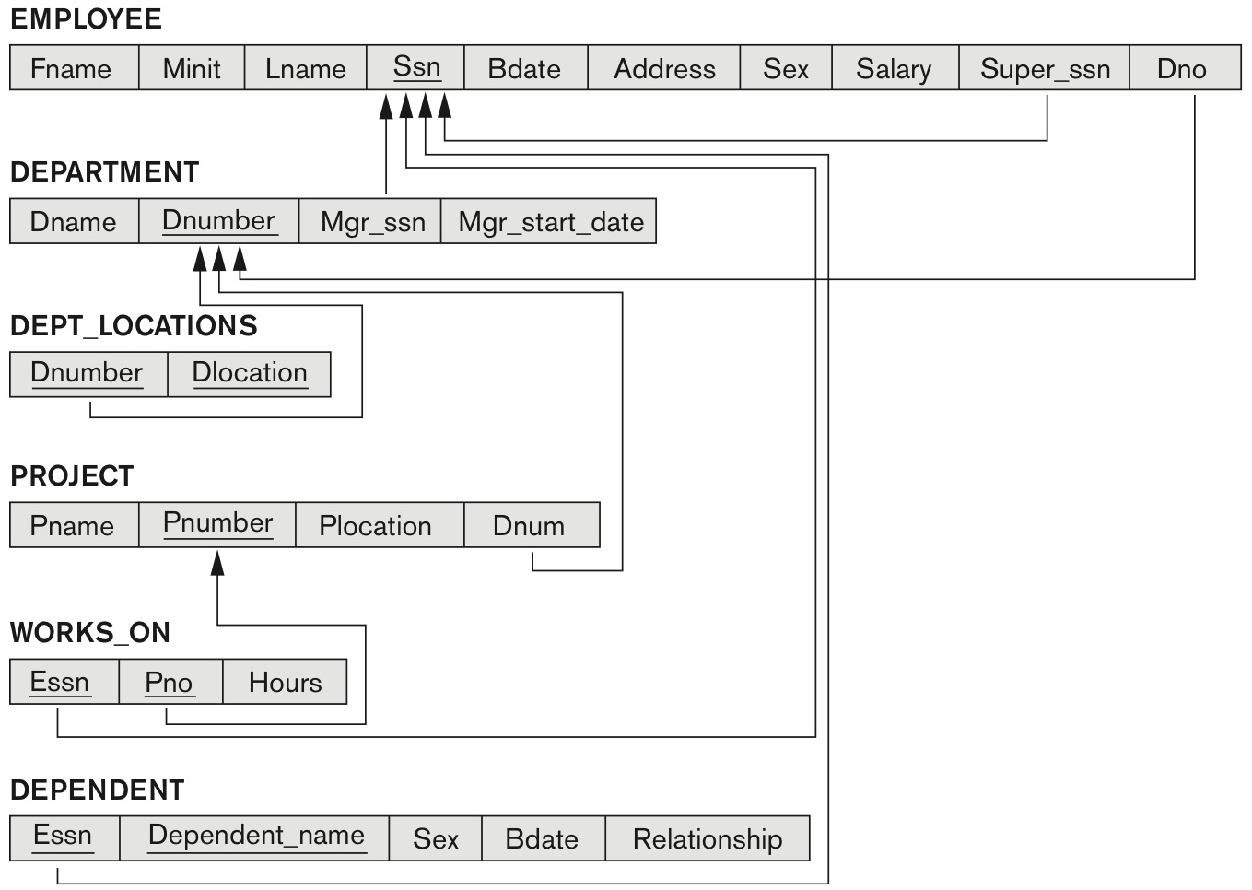
Company database – relational model

